Slide 1
Heart Disease Prediction Using Machine Learning

Slide 2
Heart Diseases – A MAJOR PROBLEM
Heart disease is responsible for most deaths worldwide for both men and women of all races .
An estimated 17.9 million people died from heart diseses in 2019, representing 32% of all global deaths.
Of these deaths, 85% were due to heart attack and stroke.

Slide 3
More about project :
Model to predict heart disease using attributes like age ,sex, cholesterol ,fbs , etc .
Model is based on logistic regression .
Libraries used :
NUMPY
PANDAS
MATPLOTLIB
SKLEARN
SEABORN
Different visualisation methods used for better understanding .

Slide 4
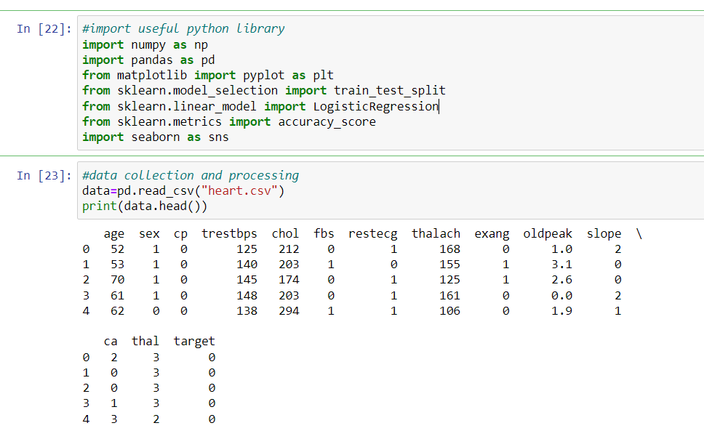
Importing necessary libraries or dependencies . The data is read thorugh a csv file.

Slide 5
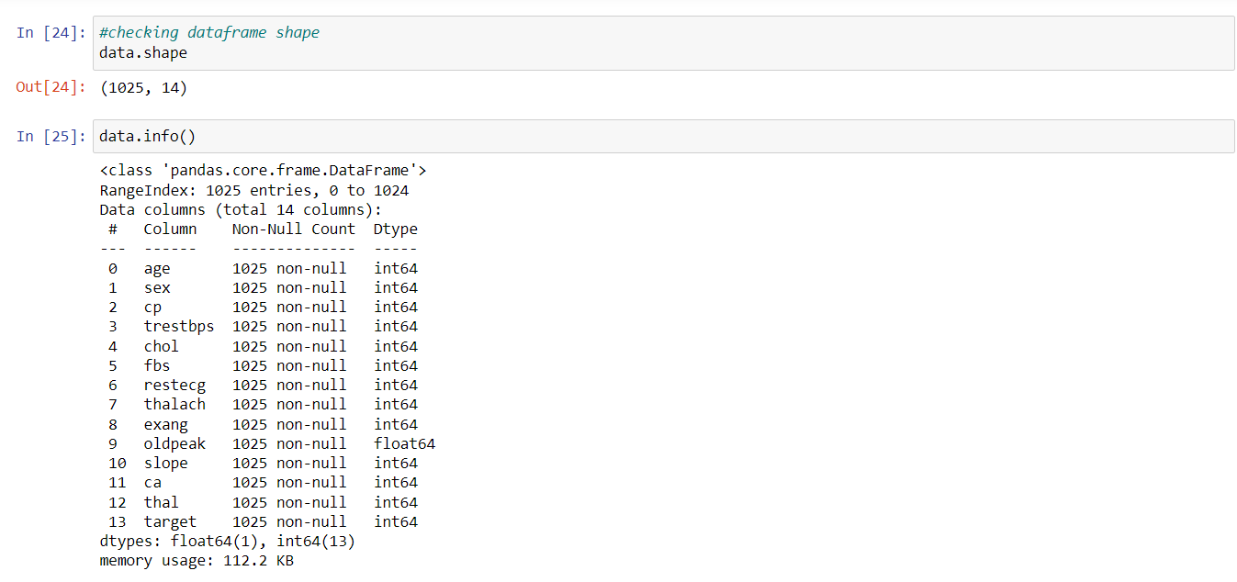
Checking the shape of dataset and gathering more information about data . Our data set have 1025 rows and 14 columns.

Slide 6
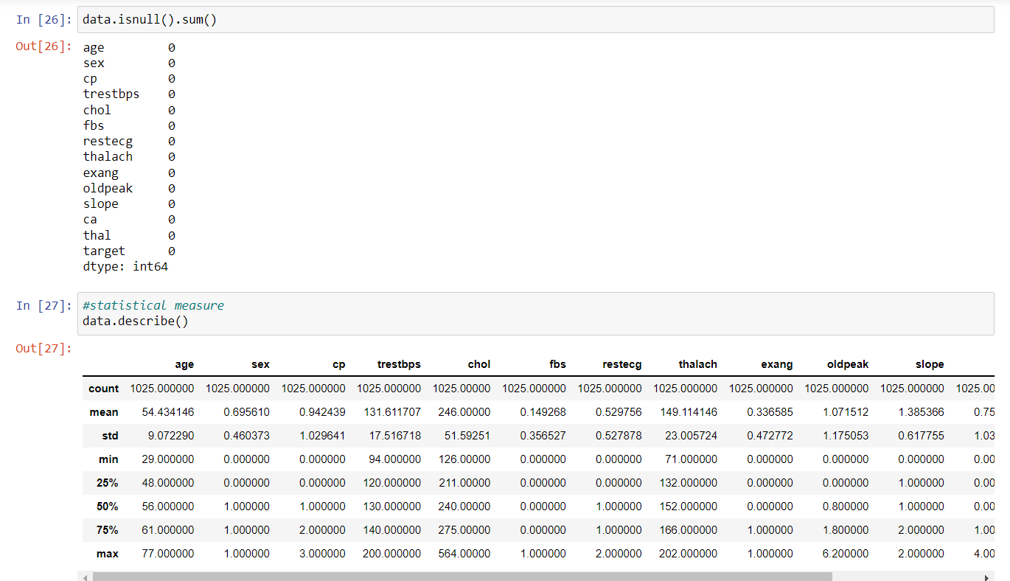
We check null entry in dataset , if any exists , then we either remove that row or replace it with Mean/Median/Mode. Here we have no null entry so action required.

Slide 7
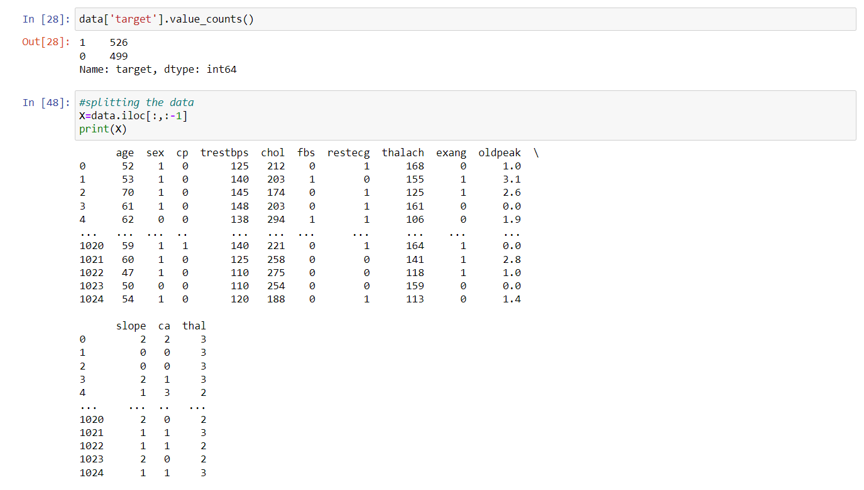
This dataset have total 14 column . So 0 to 13 columns are consists independent attributes or variable and column 14 consists target variable (0/1).

Slide 8
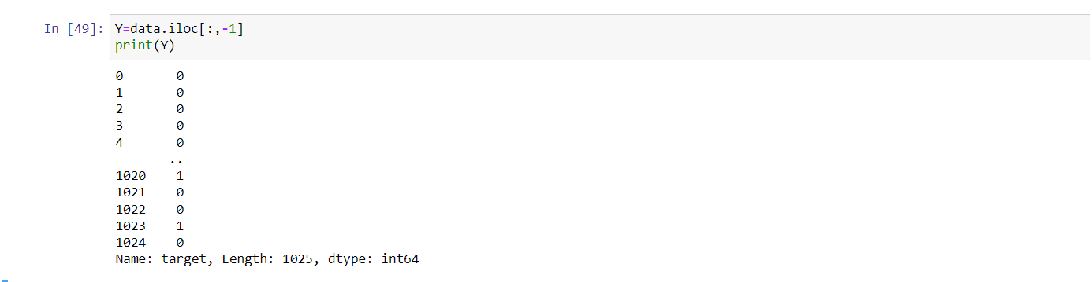
Here Y variable contains target values in form of 0 or 1. 0 = The Person does not have a heart disease. 1 = The Person has heart disease.

Slide 9
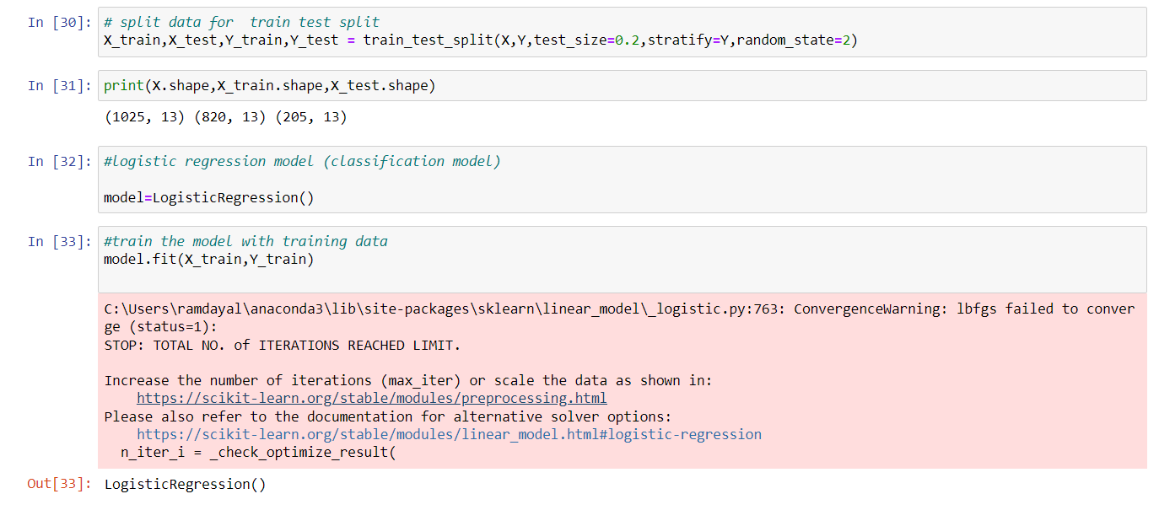
After the data preprocessing , now we split the dataset in training and testing data. And with the help of logistic Regression supervised machine learning algorithm we train our model .

Slide 10
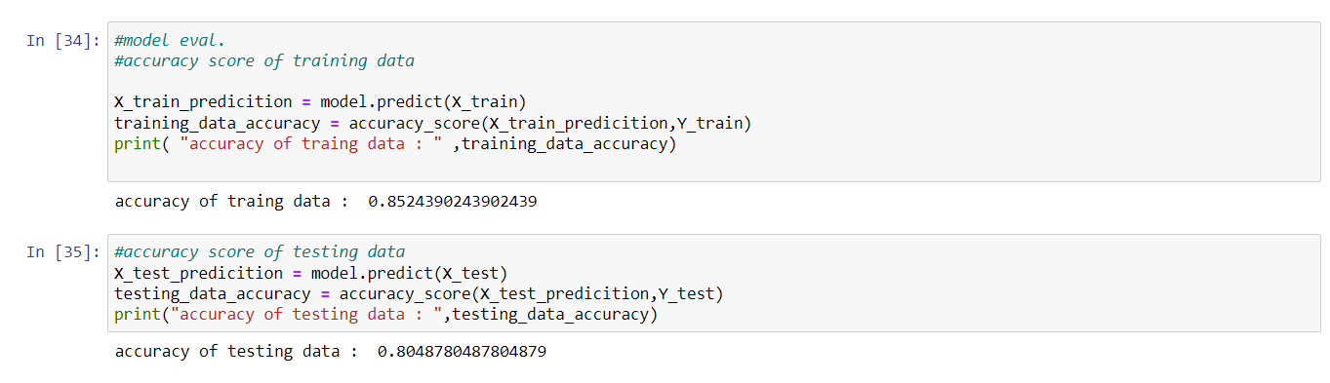
We also need to check accuracy of model here we are getting 85% accuracy of training data and 80% accuracy of testing data.

Slide 11
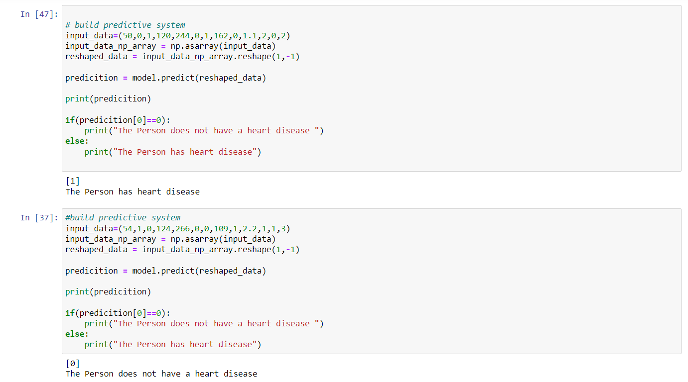
Here we build a predictive system to make it easy for user to understand output of prediction. User needs to enter the required information and will get the output that he/she have any heart related disease or not.

Slide 12
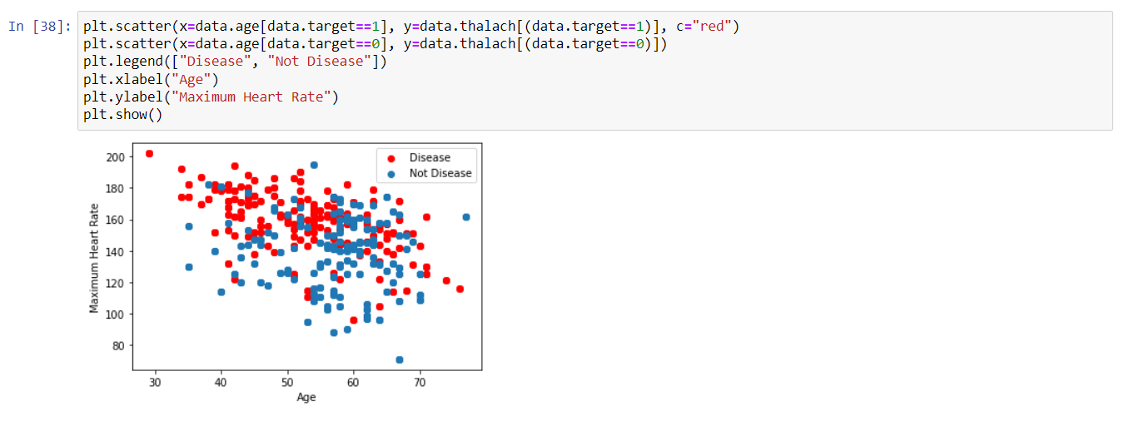
Now Here we are visualizing our model with the help of different python libraries like matplotlib ,seaborn . This scatter plot just showing that

Slide 13
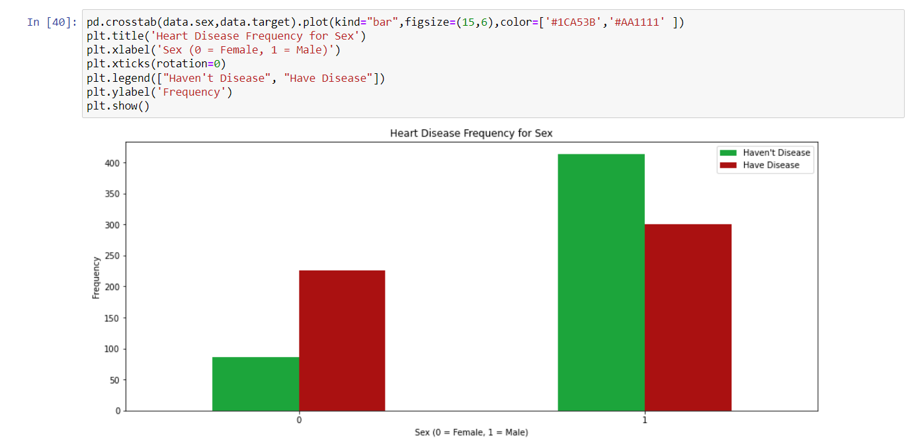
This Plot showing Heart Disease Frequency against gender.

Slide 14
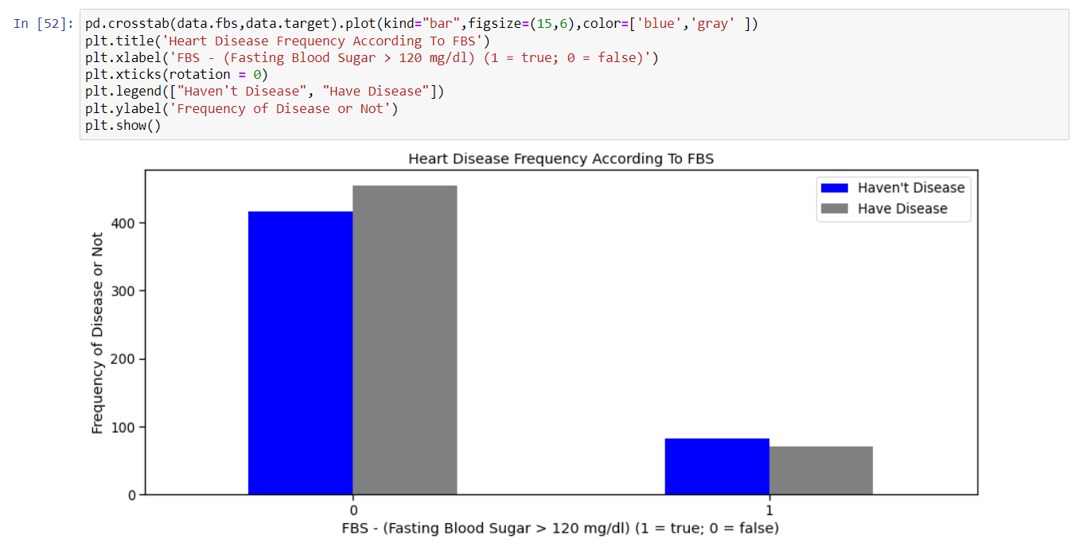
This Plot showing Heart Disease Frequency according to FBS(fasting blood sugar ).

Slide 15
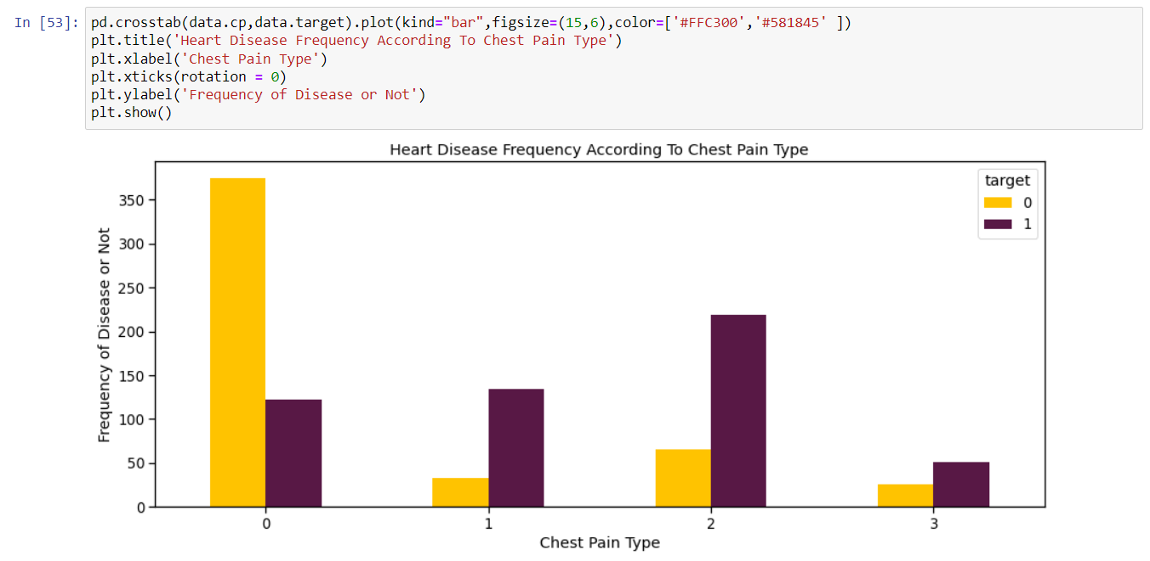
This Plot showing Heart Disease Frequency according to Chest Pain Type.

Slide 16
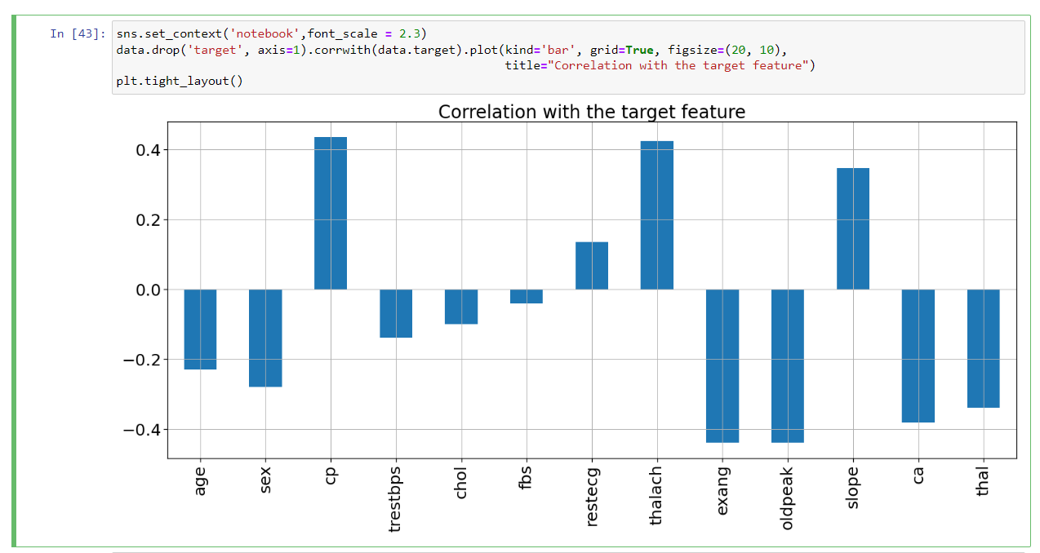
In This plot Four feature( “cp”, “restecg”, “thalach”, “slope” ) are positively correlated with the target feature. Other features are negatively correlated with the target feature.

Slide 17
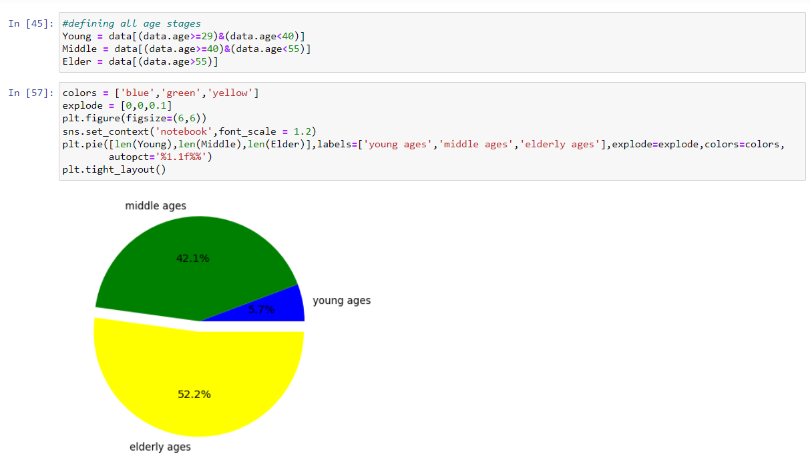
Here In This Pie chart we can see that elder people are the most affected by heart disease and young ones are the least affected.

Slide 18
Team members:
Special thanks to our worthy teacher Prof. Mrs Jagdeep Kaur because this project could not have been accomplished without her teachings and blessings.
Rajveer singh(20103118) Ramdayal (20103119)

